Slide 1
Discrete Structure
Lecture no 6
Instructor
Tariq Javed

Slide 2
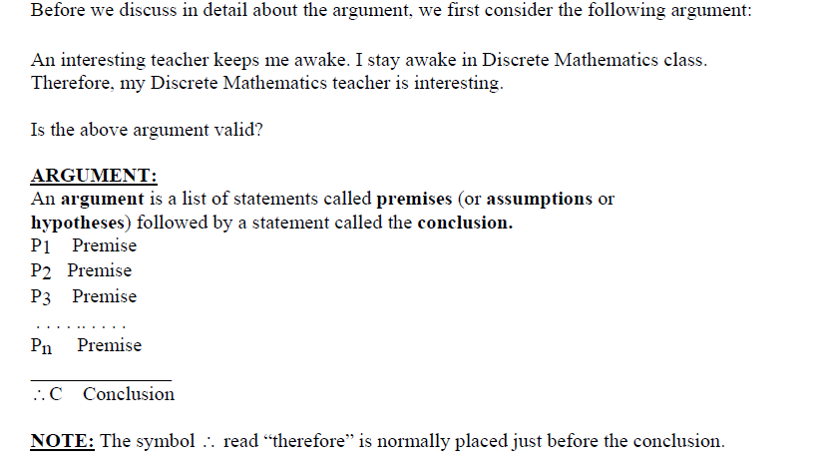
Argument

Slide 3
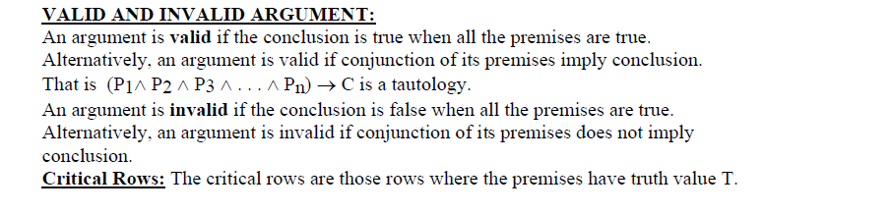

Slide 4
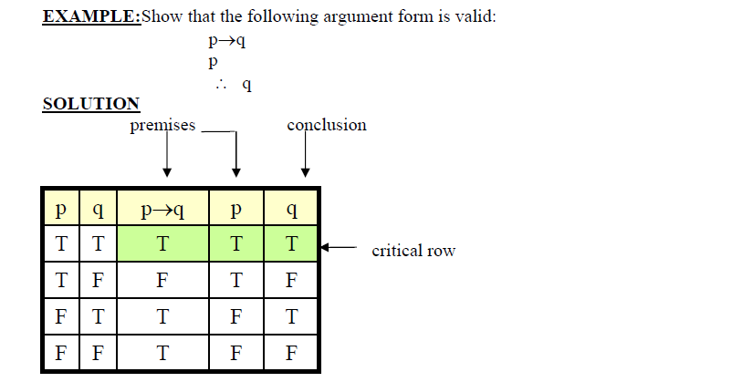

Slide 5
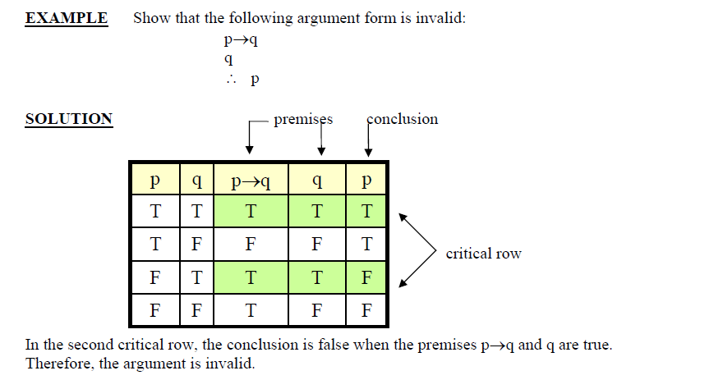

Slide 6
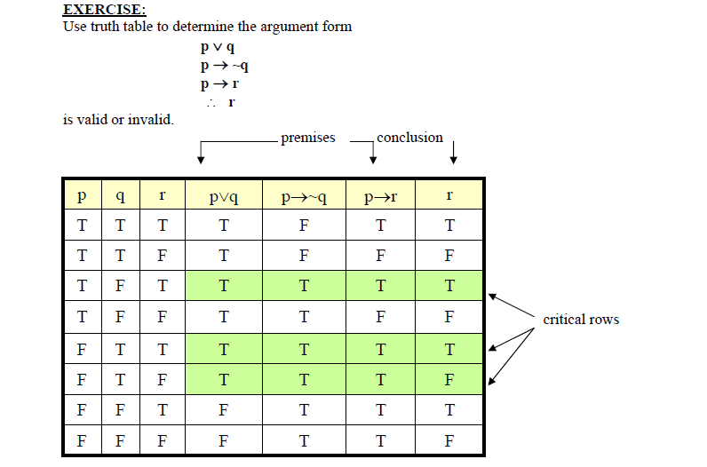

Slide 7
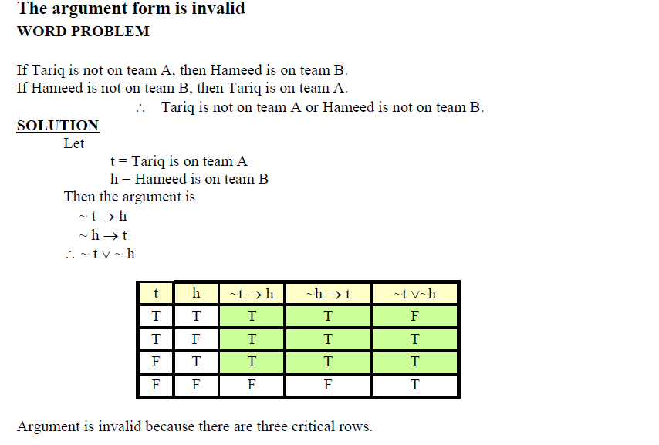

Slide 8
Argument is invalid because there are three critical rows.
( Remember that the critical rows are those rows where the premises have truth value T)
and in the first critical row conclusion has truth value F.
(Also remember that we say an argument is valid if in all critical rows conclusion has
truth value T)

Slide 9
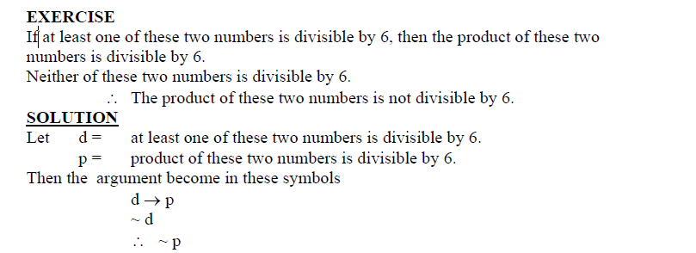
We will made the truth table for premises and conclusion as given in next page

Slide 10
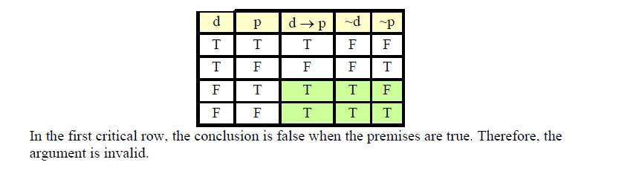

Slide 11
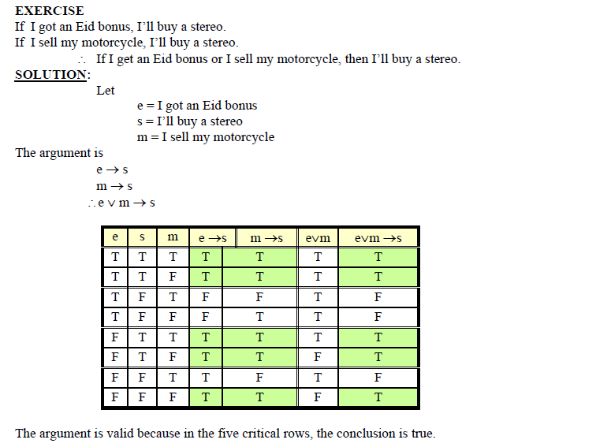

Slide 12
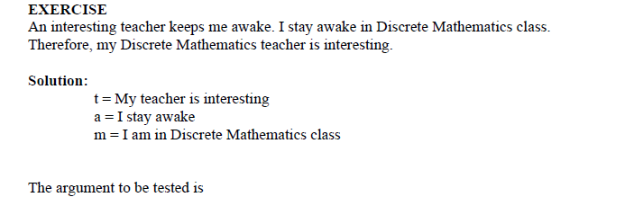

Slide 13
